Slide 1
Chapter 7
Run Time Enviorments

Slide 2
Runtime Environments
Manages memory, registers, and resources during program execution.
Handles memory allocation, procedure execution, and variable scoping.
Three Runtime Environment Types:
Fully Static:
  Pre-allocated memory (e.g., FORTRAN77).
  No recursion or dynamic allocation.
Stack-Based:
  Supports recursion via activation records (e.g., C, Pascal).
Fully Dynamic:
  Runtime allocation with garbage collection (e.g., LISP, Java).

Slide 3
Runtime enviorment
Design Importance:
  Manages variable scoping and memory allocation.
  Implements parameter-passing mechanisms (call-by-value, call-by-reference).
  Optimizes program execution on the target machine.
Compiler’s Role:
  Generates code to manage the runtime environment.
  Ensures compatibility with OS and hardware.
Sets the foundation for exploring memory organization, calling conventions, and dynamic allocation.

Slide 4
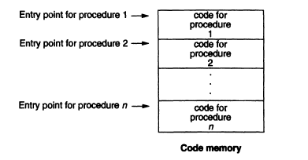

Slide 5
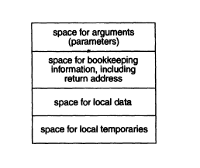
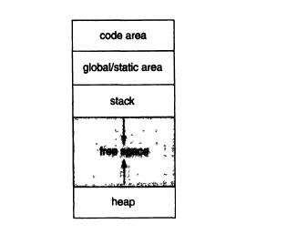

Slide 6
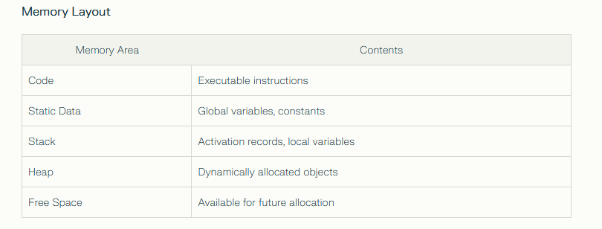

Slide 7
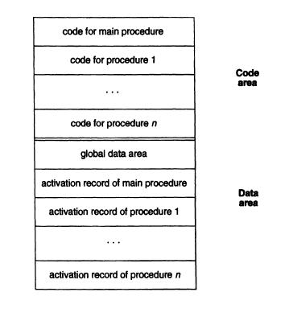
Fully Static Runtime Environments

Slide 8
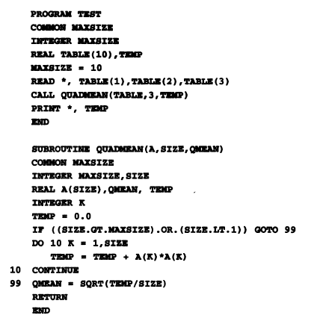
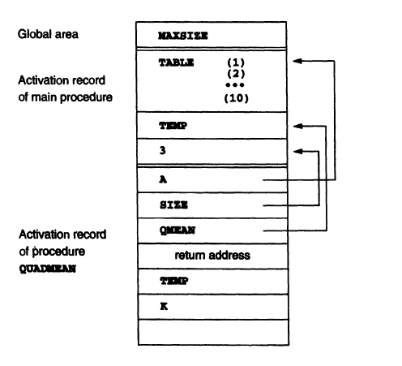

Slide 9
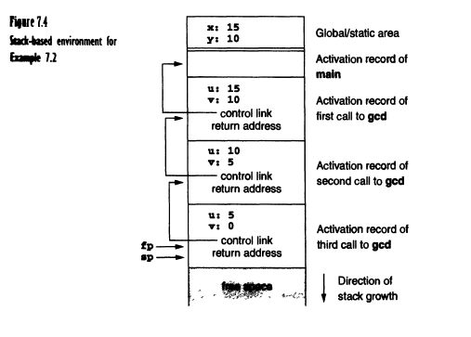
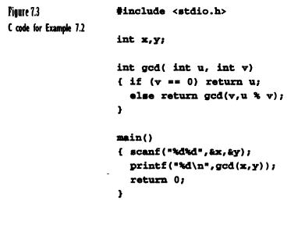
Stack based Run time Environments

Slide 10
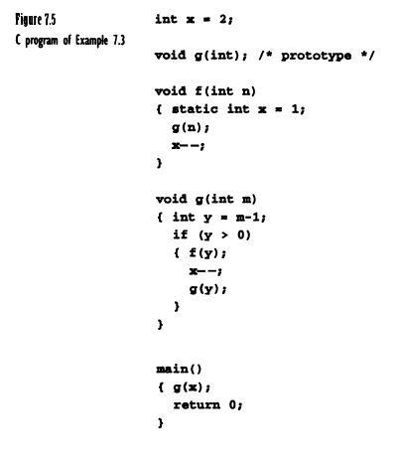
Example 7.3

Slide 11
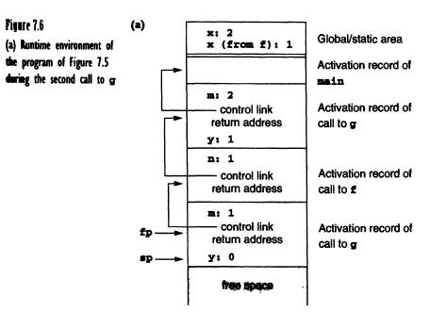
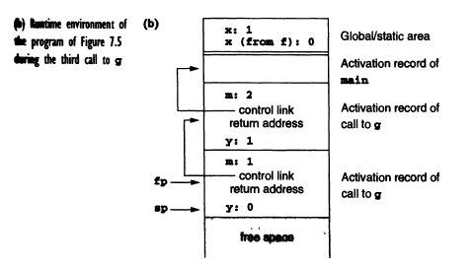
Example 7.3

Slide 12
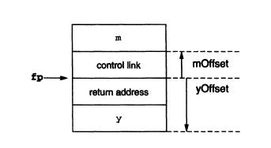
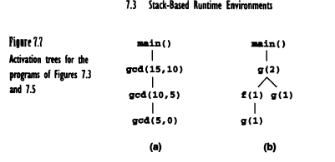

Slide 13
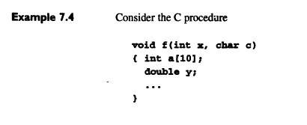
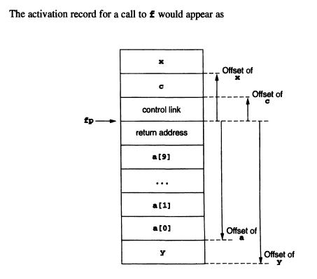

Slide 14
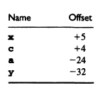

Slide 15
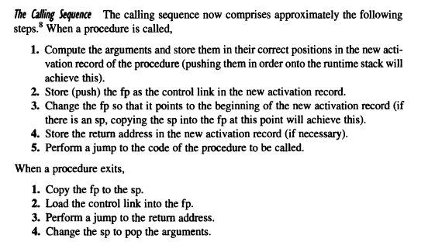

Slide 16

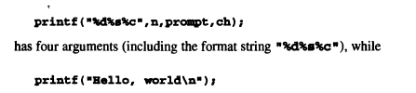
Variable Length Data

Slide 17
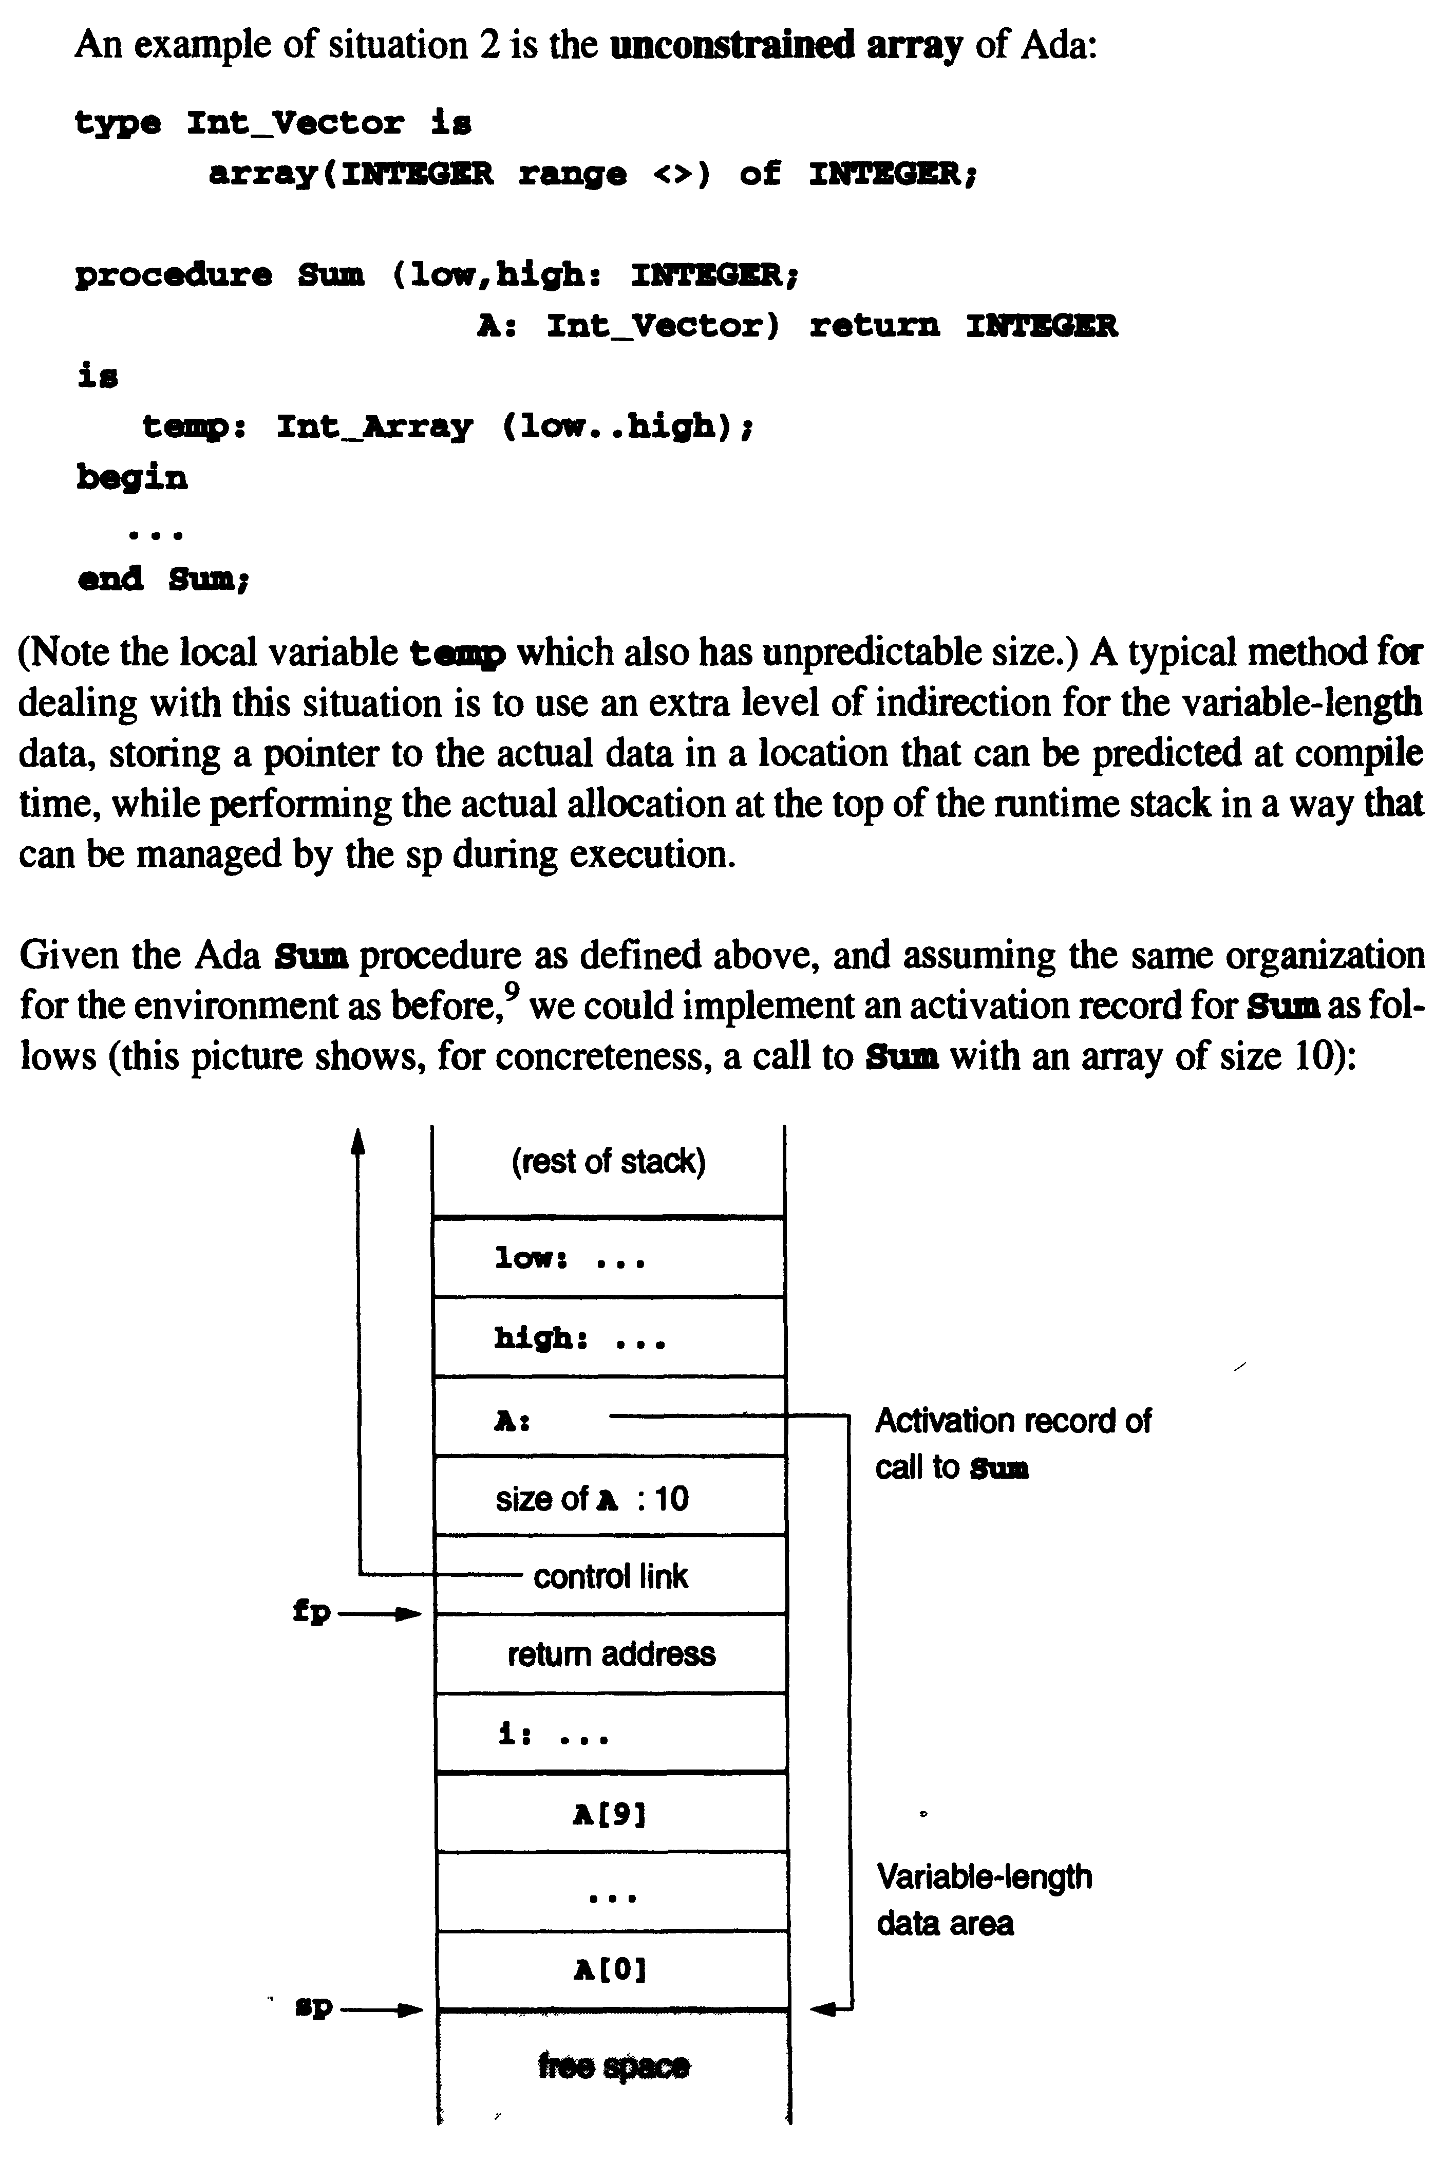
Parameter and local Variable variable length

Slide 18
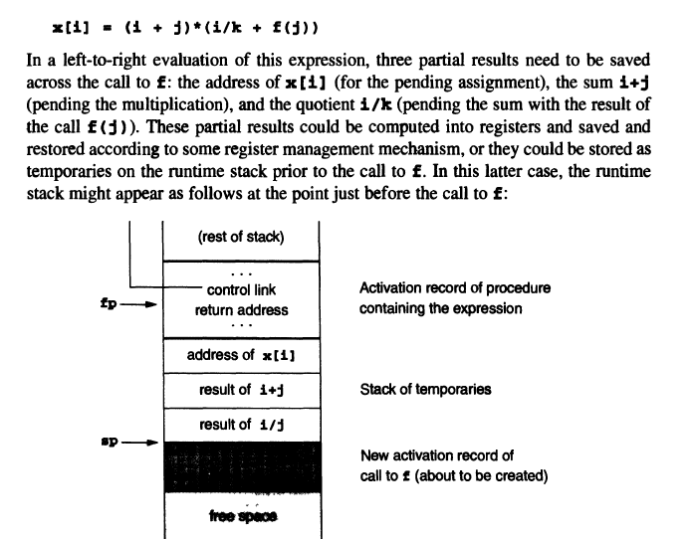
Local Temporaries

Slide 19
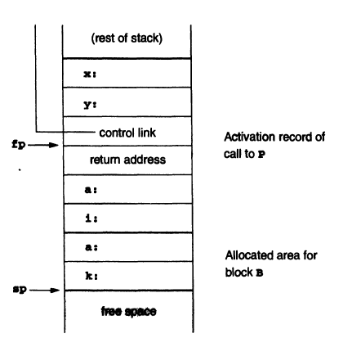
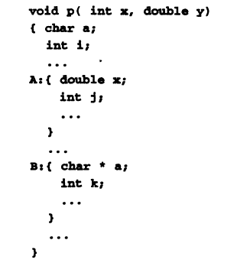
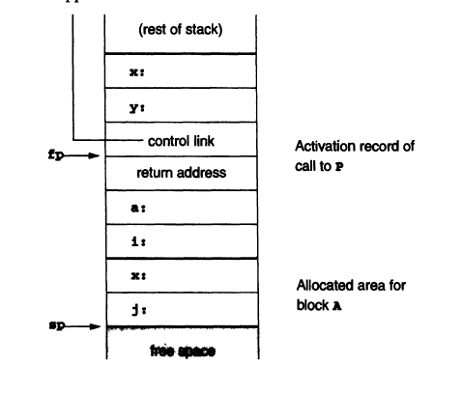
Nested Declaration

Slide 20
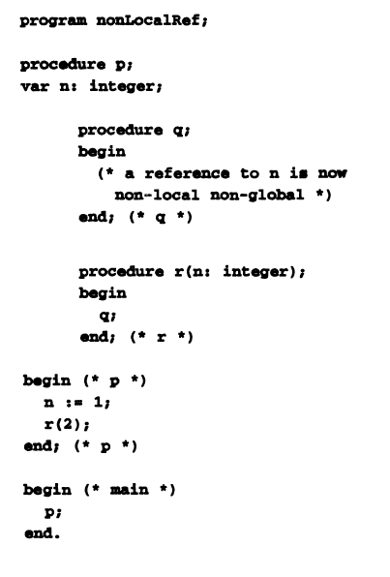
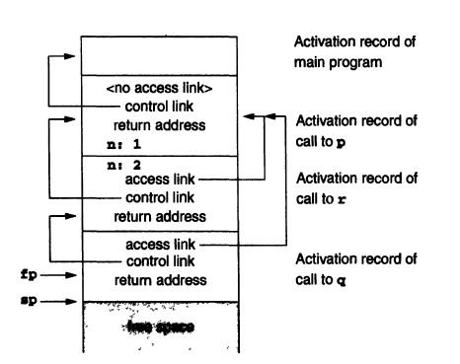
Stack Based Environments with local procedures

Slide 21
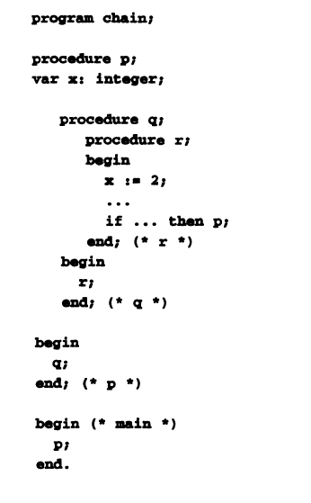
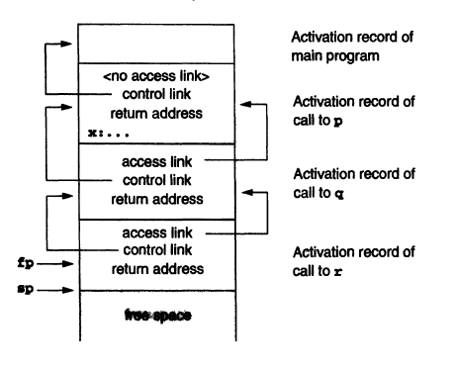

Slide 22
Dynamic Memory
Memory allocated at runtime (not compile time).
  Data structures with variable size (e.g., linked lists, trees).
  Objects in OOP languages (e.g., Java, C++).
Memory Segments:
  Heap: Primary area for dynamic allocation.
  Stack: Limited to function-local, fixed-size data.

Slide 23
Heap management
  Manages dynamic memory allocation (e.g., malloc, new).
  Handles variable-sized data structures (linked lists, trees).
Circular Linked List:
  Tracks free blocks and allocated blocks using a linked list.
  Header structure: Stores metadata (block size, next pointer).
Allocation Process:
  Search free list for a block of sufficient size.
  Split block if extra space remains.
Free Process:
  Mark block as free.
  Coalesce adjacent free blocks to reduce fragmentation.

Slide 24
Garbage Collection
Calls when malloc fails
Mark-and-Sweep:
  Mark: follow all pointers recursively and marks each block of storage reached.
  Sweep: Free unmarked (unreachable) blocks.
Stop-and-Copy:
  Divide heap into two spaces; copy live objects to new space.
  Advantage: Automatic compaction.
Generational GC:
  Prioritizes collection of short-lived objects (e.g., Java’s Young/Old generations).

Slide 25
Parameter Passing Mechanism
Call-by-Value
Mechanism:
  Copies the value of the actual parameter to the formal parameter.
  Changes to the formal parameter do not affect the actual parameter.
Implementation:
  Simplest to implement; no aliasing issues.
  Used in C, Pascal, and Ada (default).

Slide 26
Call-by-Reference
Mechanism:
  Passes the location of the actual parameter.
  Formal parameter becomes an alias for the actual parameter.
Implementation:
  Requires compiler to compute and pass addresses.
  Used in Fortran77, Pascal (var keyword), and C++ (&).

Slide 27
Call-by-Value-Result (Copy-In/Copy-Out)
Mechanism:
  Copies the value into the formal parameter at call time.
  Copies the result back to the actual parameter at return.
Implementation:
  Resembles pass-by-reference but avoids aliasing.
  Used in Ada (in out parameters).

Slide 28
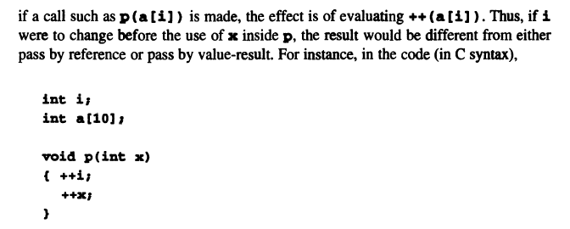
Call-by-Name (Delayed Evaluation)
Mechanism:
  Replaces every use of the formal parameter with the unevaluated expression of the actual parameter.
  Evaluated each time it is referenced.

Slide 29
